Slide 1
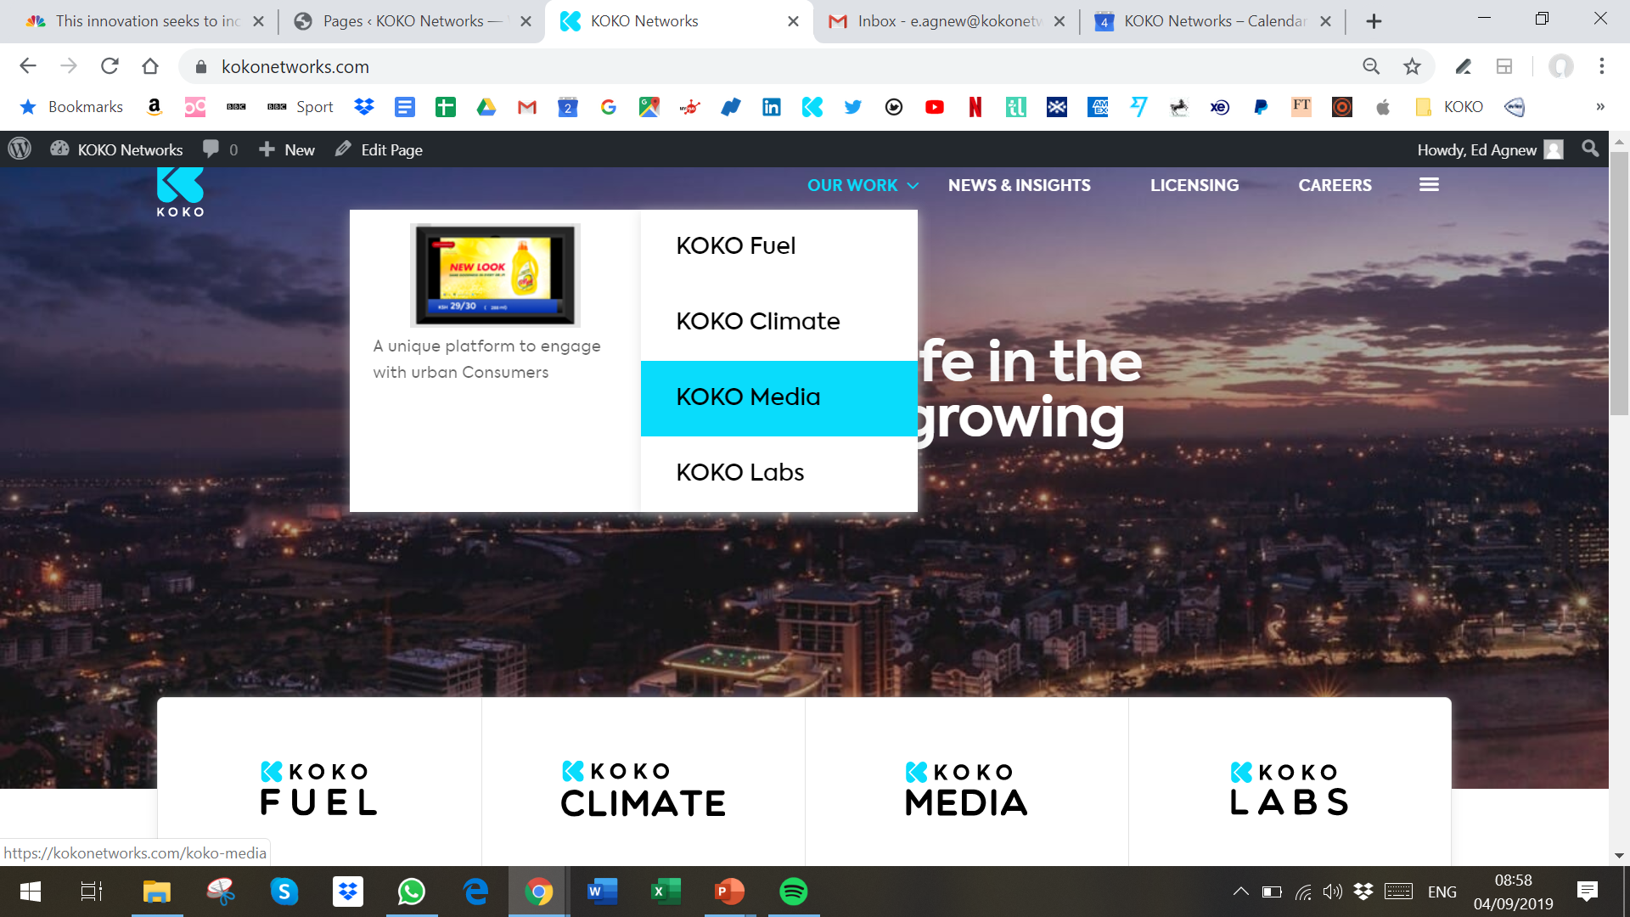
I need to be able to edit the image + text for all the items in the drop-down menu. Also, the spacing is off – can we move the text lower down and make it centered?

Slide 2
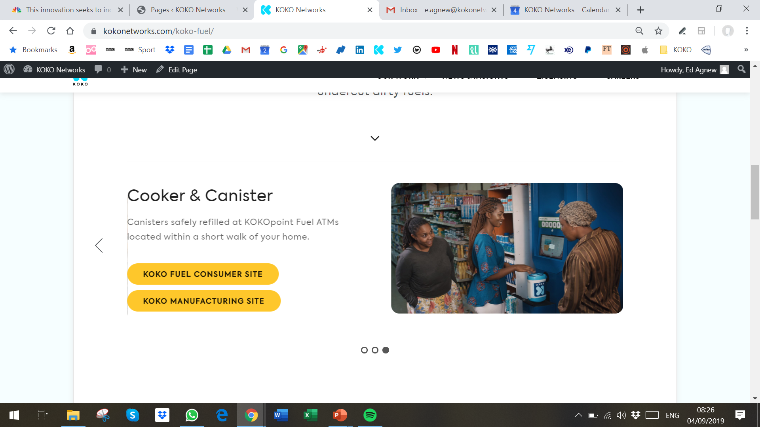
There is an over-hand from the previous photo, so that we are getting this line appearing

Slide 3
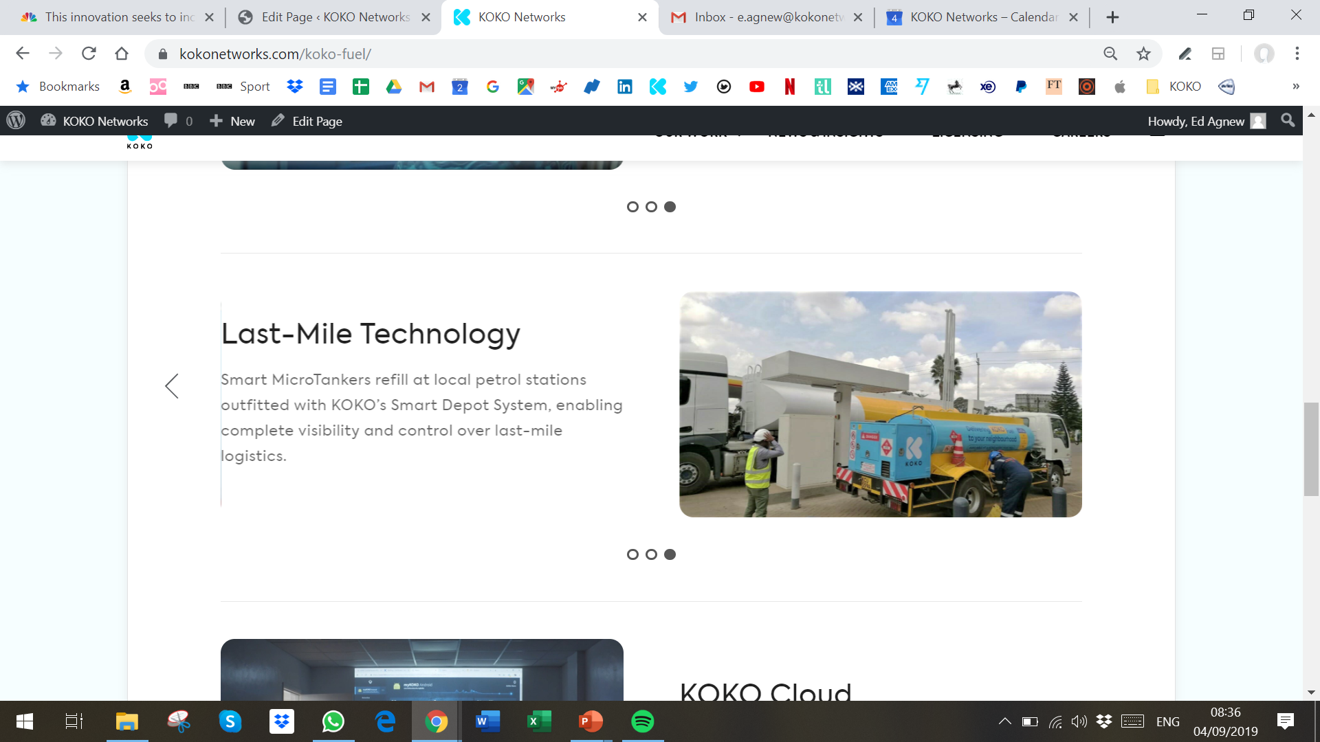
There is an over-hand from the previous photo, so that we are getting this line appearing

Slide 4
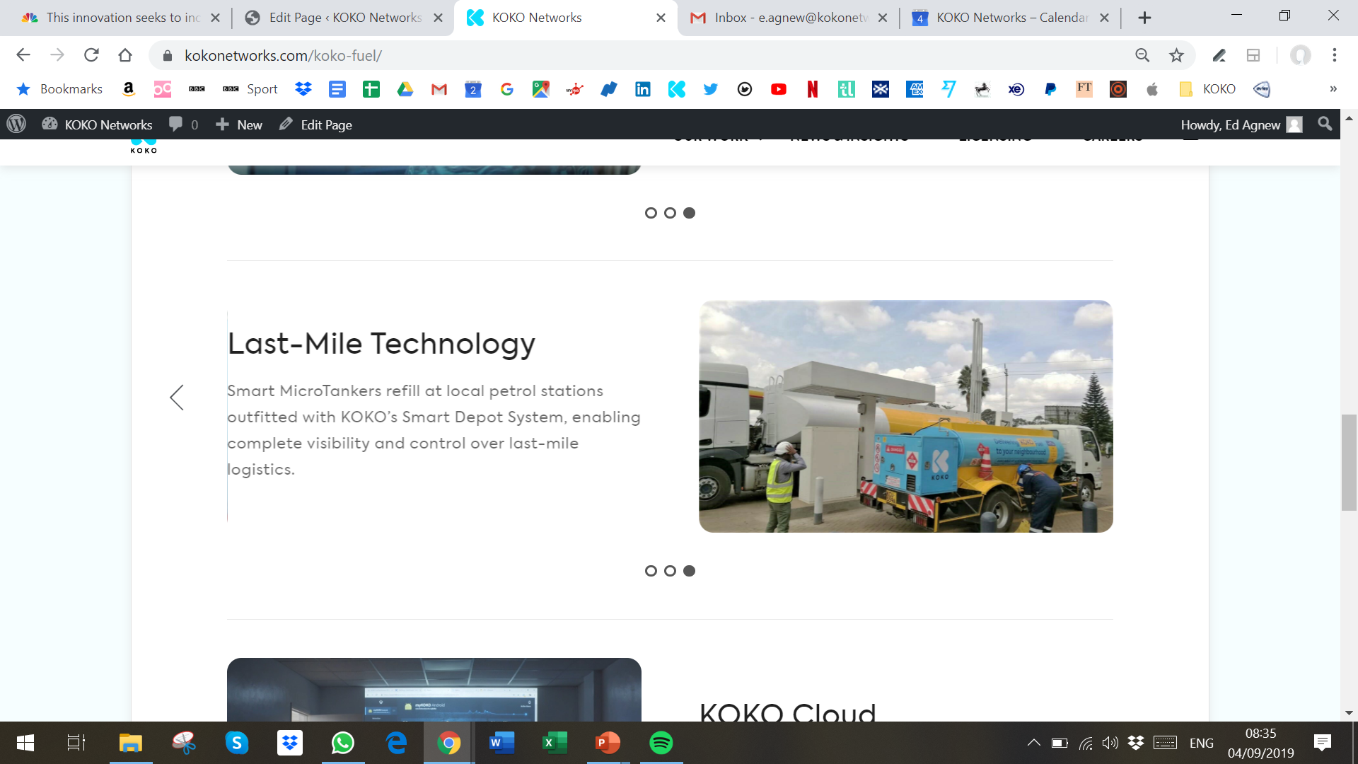
There is an over-hand from the previous photo, so that we are getting this line appearing

Slide 5
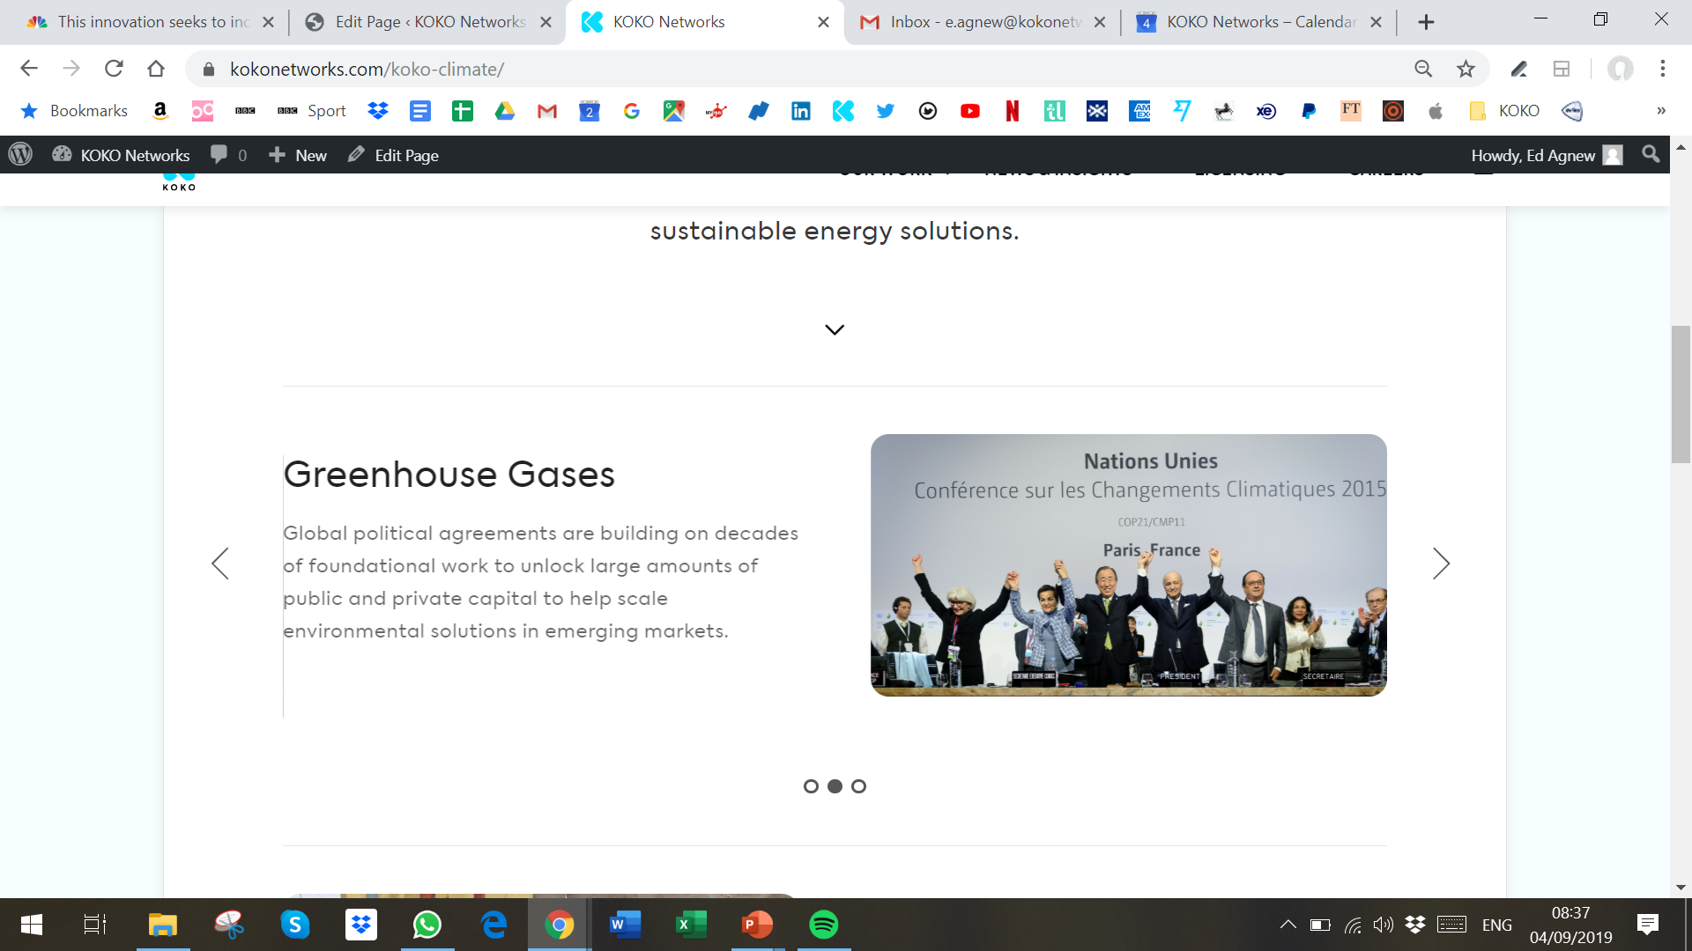
There is an over-hand from the previous photo, so that we are getting this line appearing

Slide 6
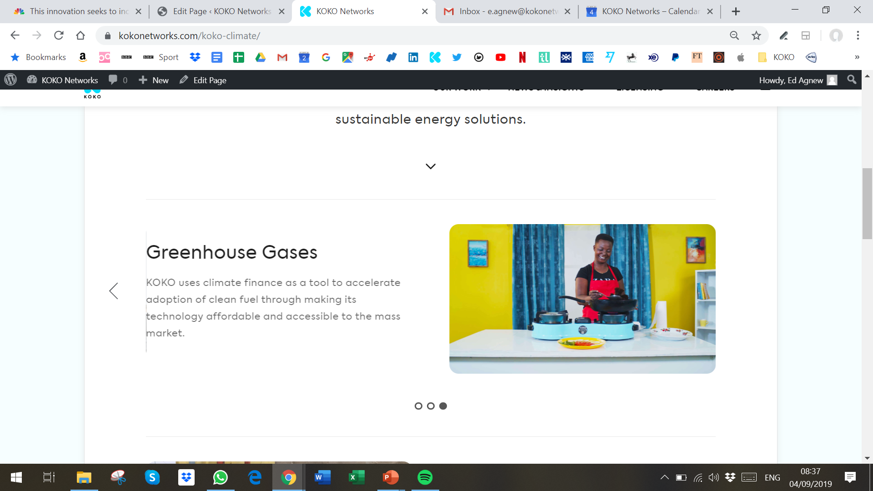
There is an over-hand from the previous photo, so that we are getting this line appearing

Slide 7
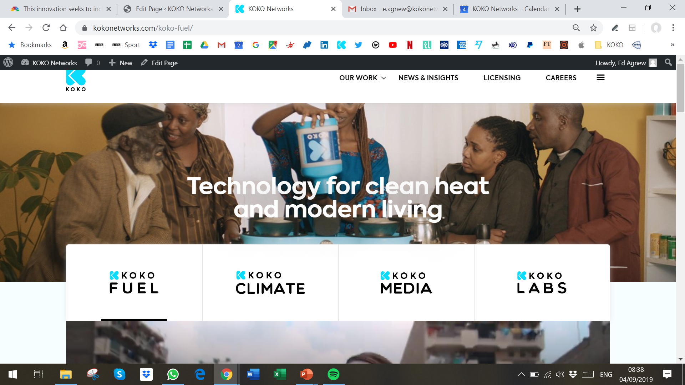
The “News & Insights” option should now be removed from the NavBar

Slide 8
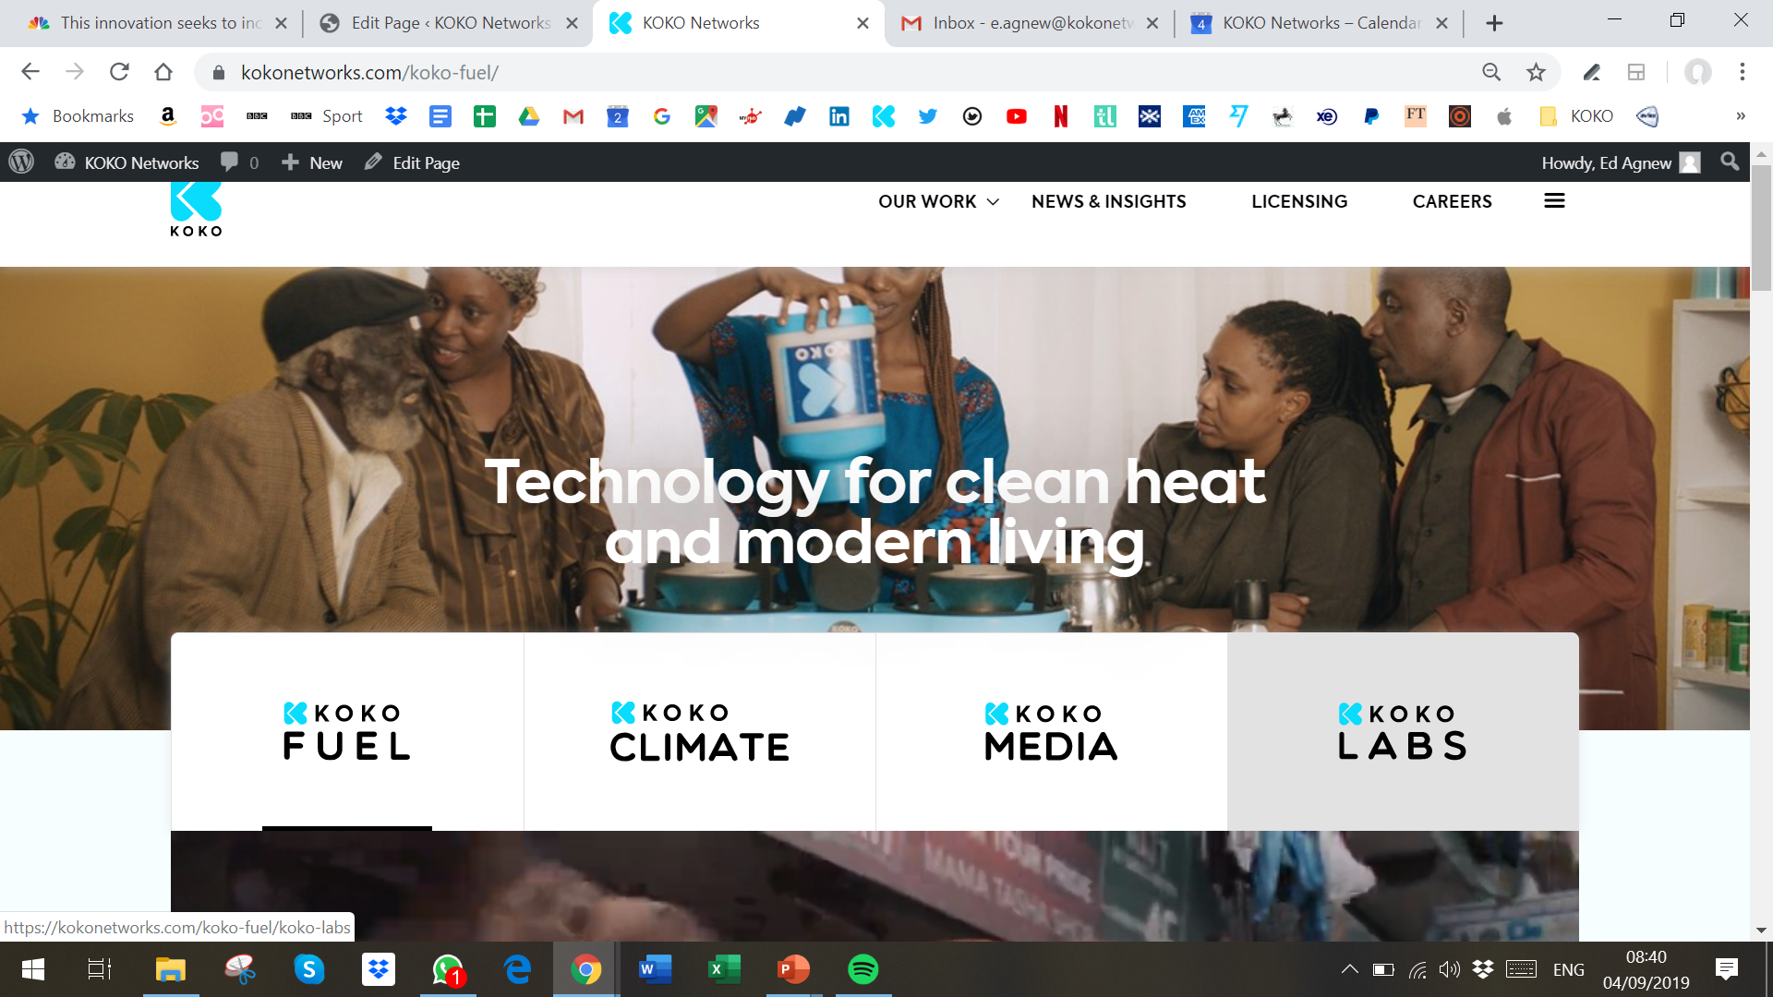
The NavBar covers the banner image too much – the lady’s face is too covered. This is even worse on mobile

Slide 9
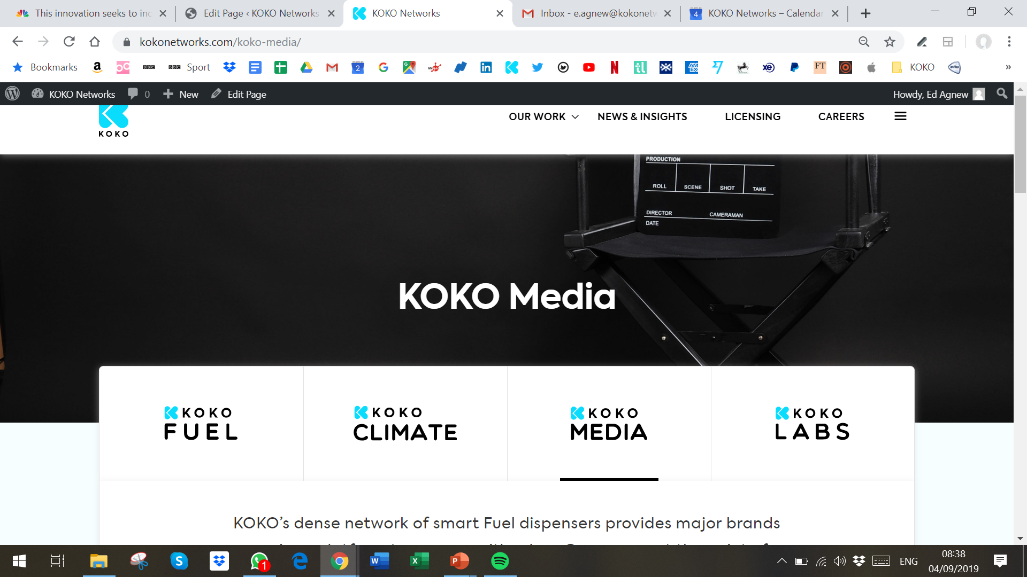
The NavBar covers the banner image too much. This is even worse on mobile

Slide 10
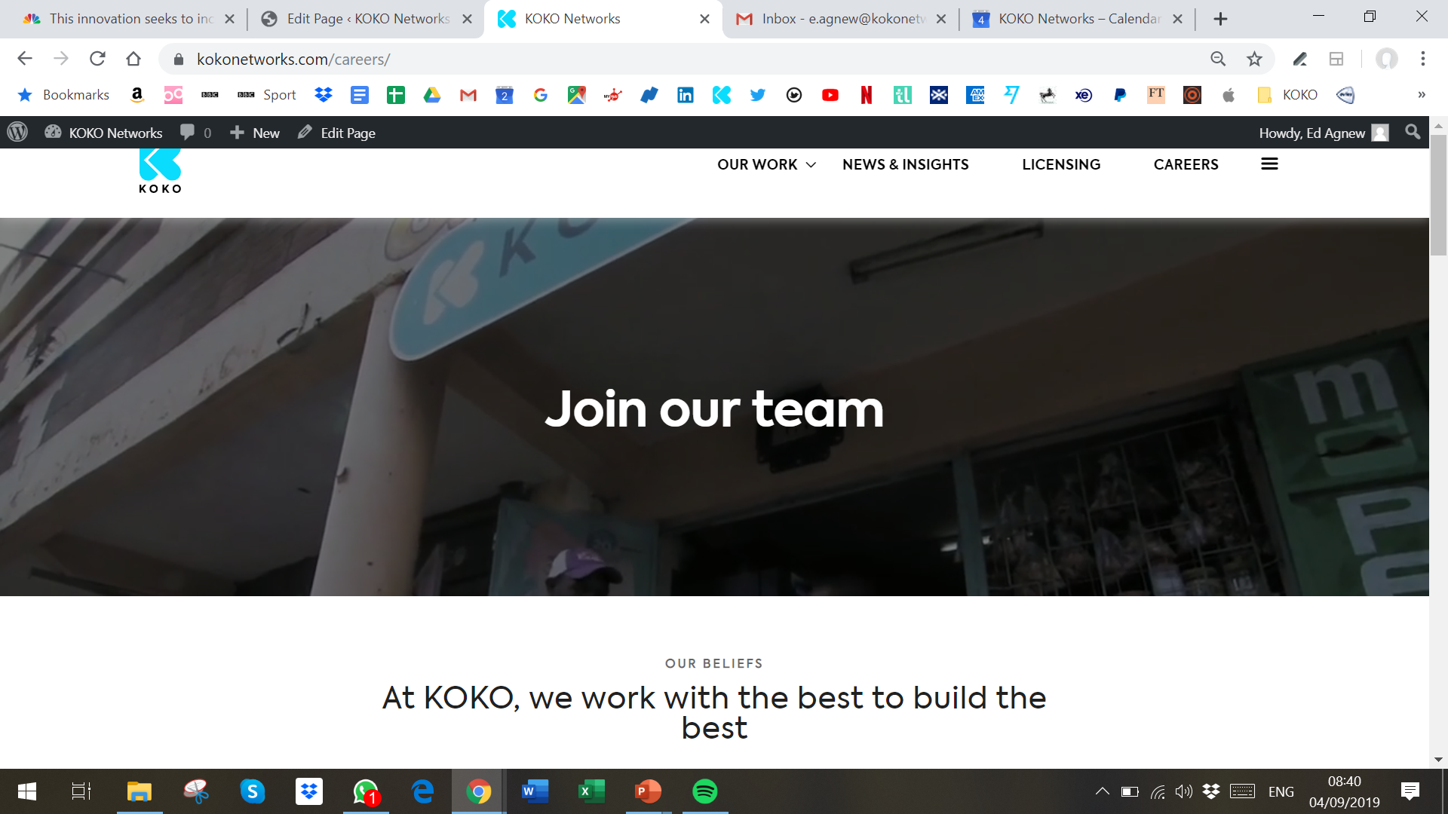
The video loop that plays on the Careers page is too narrow – often content at the bottom of the video is cut off so that you can’t see crucial parts (e.g. in this screenshot, you cannot see the customer at all). This is even worse on mobile

Slide 11
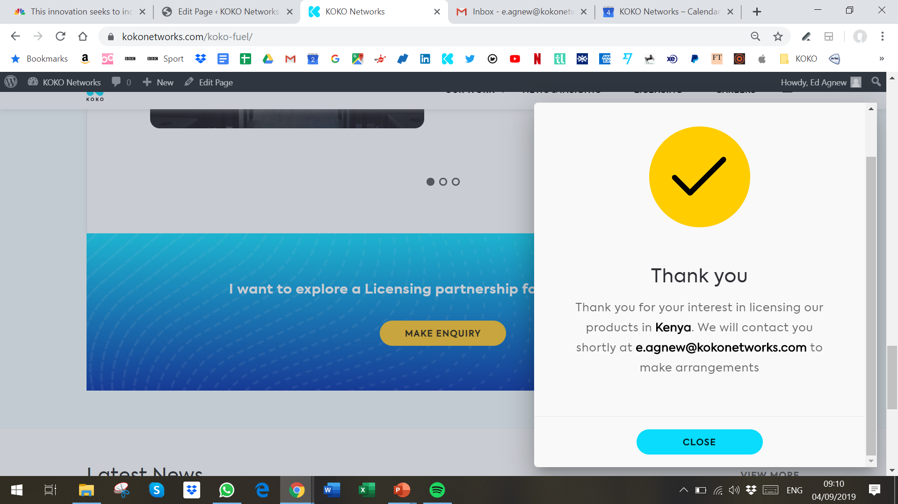
Once you click “Close” on one of the contact forms, it should close the whole pop-up window, rather than opening up a fresh (blank) contact form

Slide 12
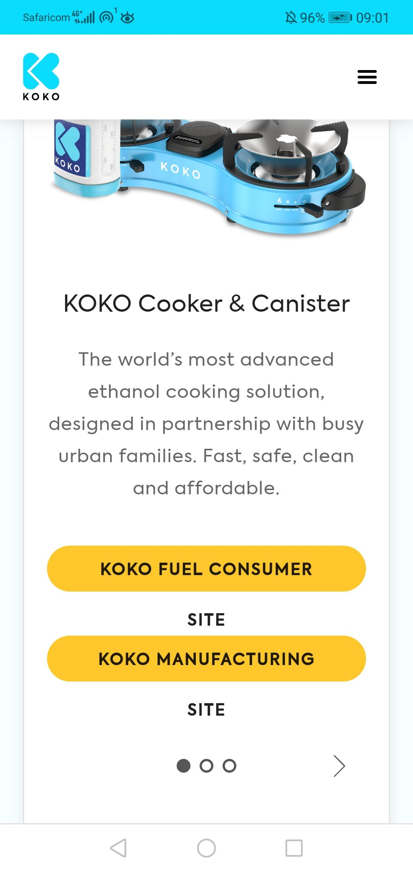
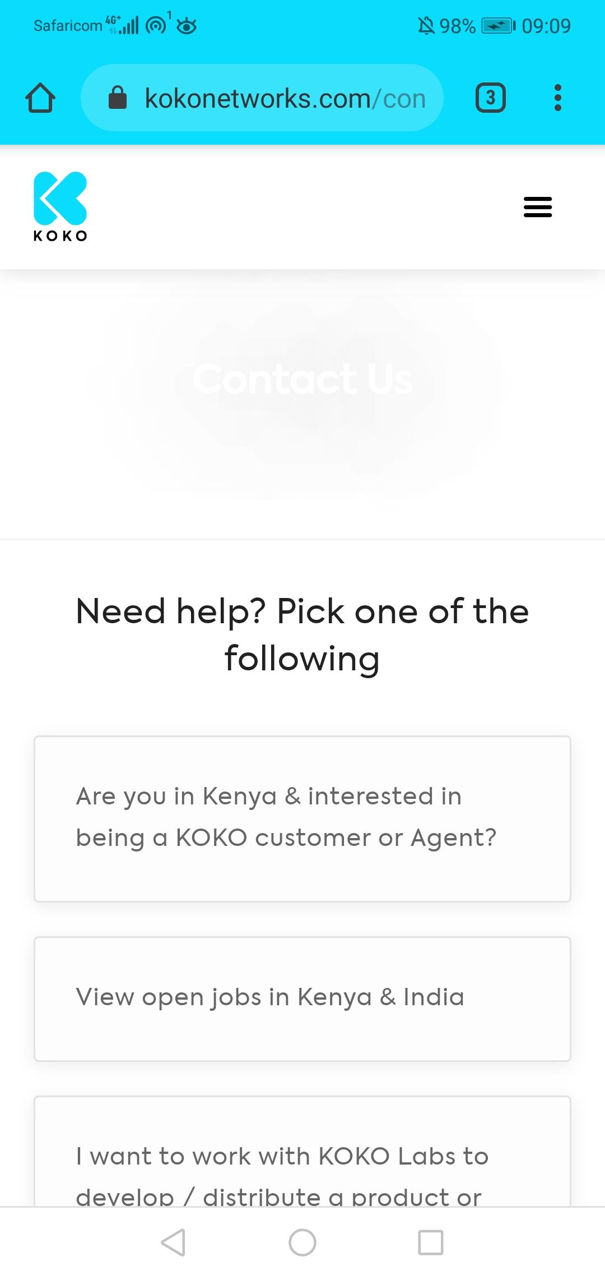
For some reason, the banner image for the Contact Us page is not displaying on mobile (it is displaying on desktop though)
On mobile only, these yellow bars on the KOKO Fuel page need fixing (text is over-running)

